Slide 1

Face Detection
University Roll No-2018686
Section – D
Group – G1
Class Roll No- 07
Course- B.TECH
Branch- CSE
Submitted By-Ankit Pundir
Mentor - Mr. Saurabh Kumar Mishra

Slide 2
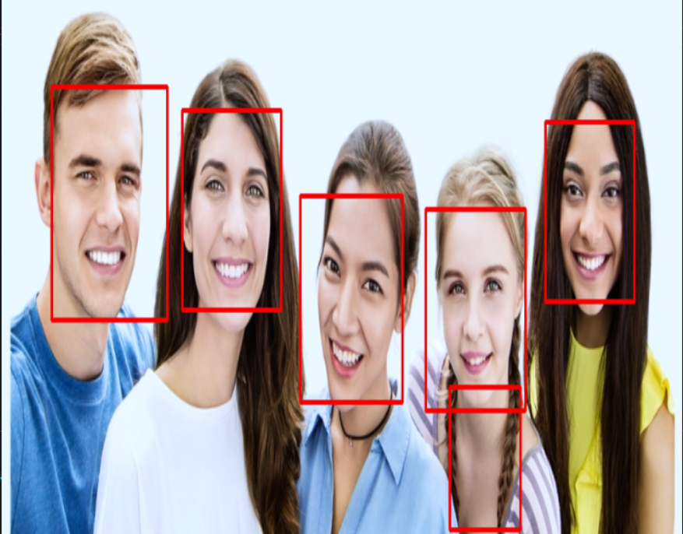
Introduction
Face detection is a computer vision technology that helps to locate/visualize human faces in digital images. This technique is a specific use case of object detection technology that deals with detecting instances of semantic objects of a certain class (such as humans, buildings or cars) in digital images and videos. With the advent of technology, face detection has gained a lot of importance especially in fields like photography, security, and marketing.

Slide 3
Methodology
Installation :
OpenCV-Python supports all the leading platforms like Mac OS, Linux, and Windows. It can be installed in either of the following ways: Packages for standard desktop environments (Windows, macOS, almost any GNU/Linux distribution)
● run pip install opencv-python if you need only main modules
● run pip install opencv-contrib-python if you need both main and contrib modules
cv2 (OpenCV) is a library of programming functions mainly aimed at real-time computer vision. It provides a wide variety of image processing and computer vision algorithms, including feature detection and description, image segmentation, motion analysis and object tracking, stereo correspondence, and more
Haar cascades are a type of object detection method used in computer vision, primarily for detecting faces and facial features in images.The classifiers are trained on a set of positive (i.e. containing the object of interest) and negative (i.e. not containing the object of interest) images.
A cascade classifier is a machine learning based object detection method used in computer vision. It is a combination of multiple simple classifiers, called "stages", that are applied to an image in a sequential manner.

Slide 4
Steps :-
How to use a pre-trained cascade classifier to detect faces in an image using the OpenCV library (cv2). The methodology for this code is as follows:
Import the OpenCV library (cv2) at the beginning of the code.
Load a pre-trained cascade classifier for detecting faces by using the cv2.CascadeClassifier() method and passing the path to the trained data file as an argument. In this case, the trained data file is 'Face.xml'
Load an image using the cv2.imread() method and passing the path to the image file as an argument. In this case, the image file is 'my.jpg'.
Convert the image to greyscale using the cv2.cvtColor() method and passing the image and the color conversion code as arguments. This is because OpenCV works only with greyscale images.
Apply the cascade classifier to the greyscale image using the detectMultiScale() method of the classifier and passing the greyscale image as an argument. This will return an array of coordinates for any faces detected in the image.
Extract the coordinates of the first detected face from the array using the array indexing [0]
Draw a rectangle around the detected face using the cv2.rectangle() method, passing the image, the top-left and bottom-right coordinates of the rectangle, the color of the rectangle, and the thickness of the rectangle as arguments.
Resize the image using the cv2.resize() method and passing the image and the desired size as arguments.
Display the image using the cv2.imshow() method and passing the window name and the image as arguments.
Pause execution of the program using the cv2.waitKey() method until a key is pressed.
End of the program
This is a basic example and can be modified as per the requirement.

Slide 5

Result and Discussion
Conclusion:
The face detection process successfully identified faces in image containing unique face , multiple faces, webcam and even in a video frame by frame , with a high level of confidence. Based on these results, it can be concluded that the chosen cascade classifier and pre-processing steps are effective for detecting faces in this image.
Recommendations:
This process can be further improved by using more images for training the classifier to detect faces with different poses and expressions.
The confidence level can be further improved by using other techniques like deep learning.
The process can be used to detect multiple faces in a single image by applying the cascade classifier multiple times.

Slide 6
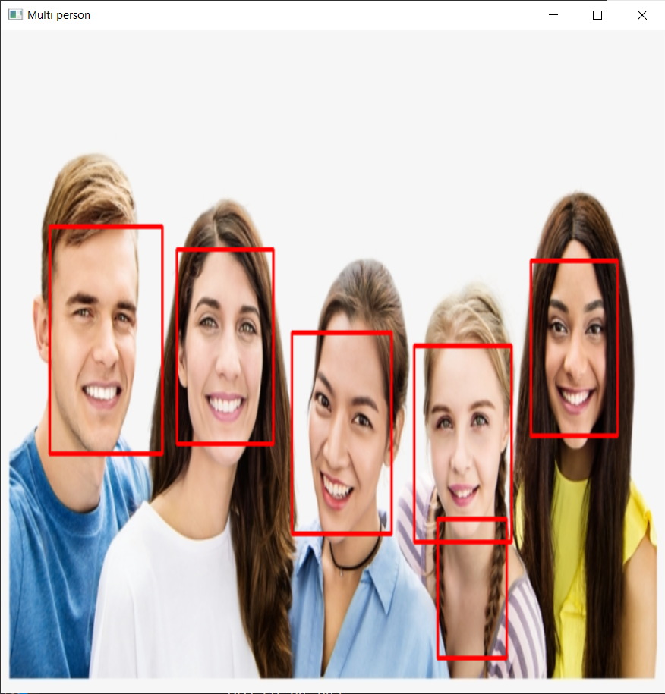
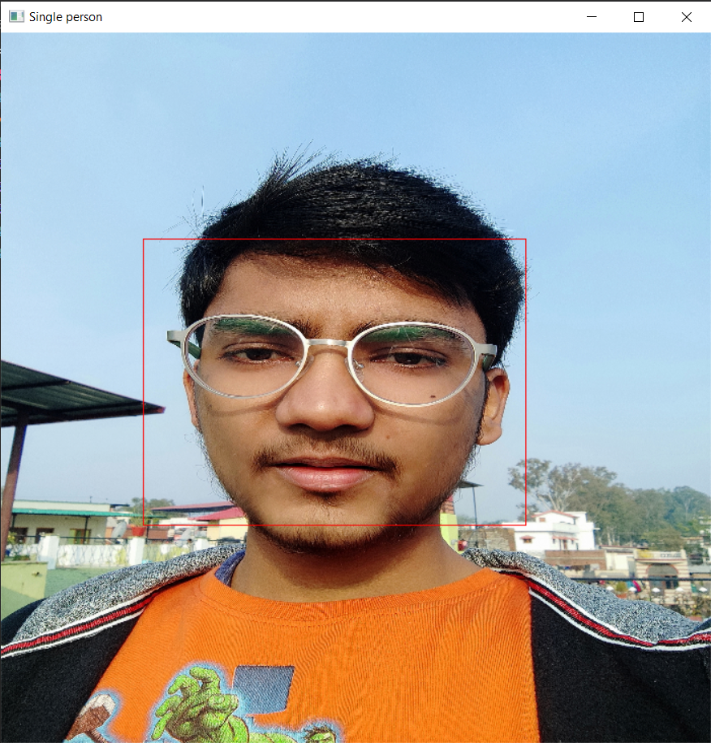
Different Sample Images/Test Cases-
Single Person Image:
Multi Person Image:

Slide 7
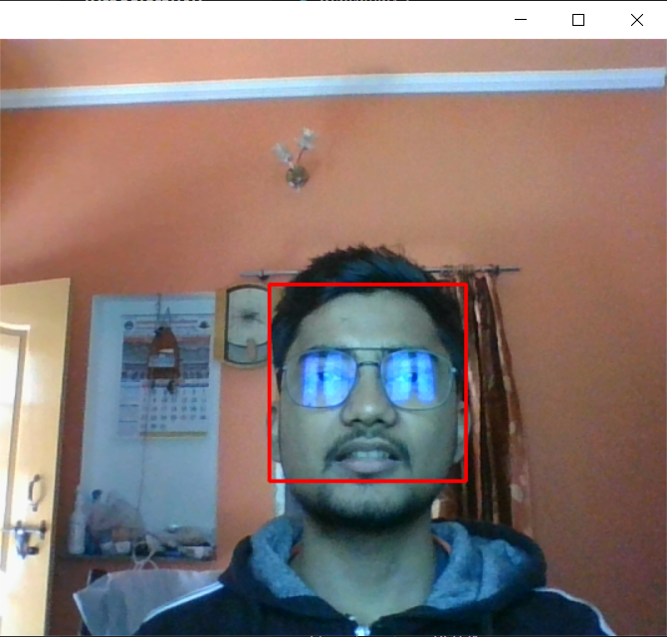
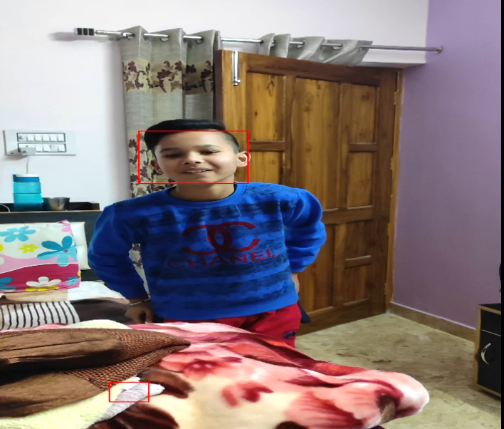
Different Moving Frames/Test Cases-
Webcam:
Video:

Slide 8
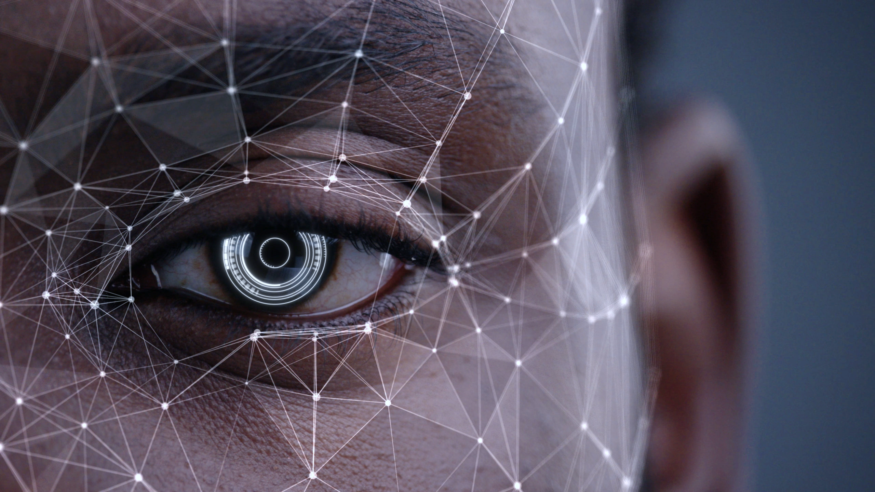
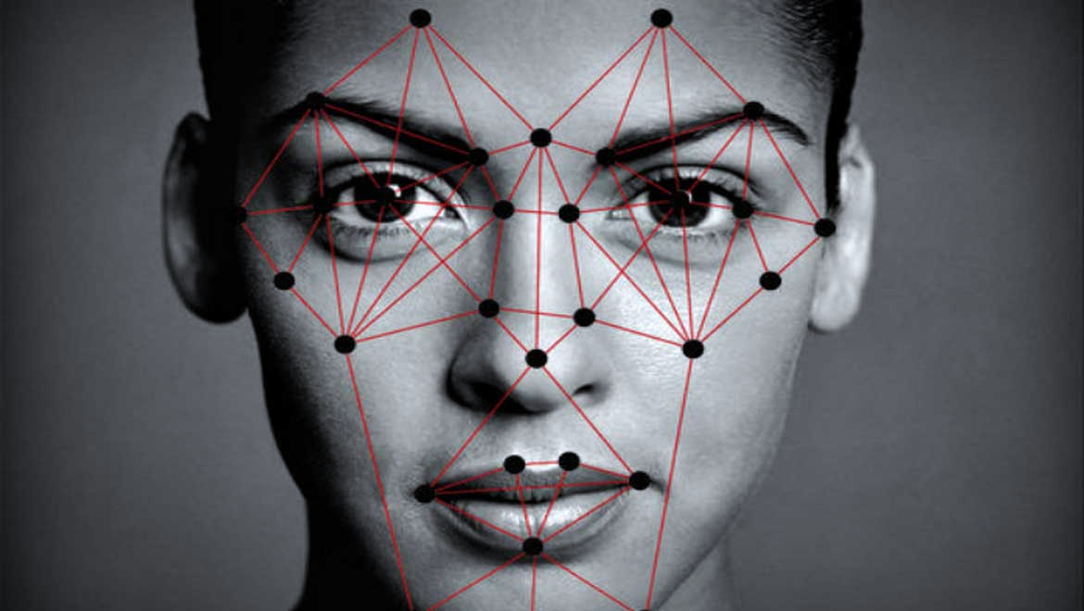
Conclusion
The face detection system has been able to successfully detect faces in the input images. The system uses the OpenCV library and a pre-trained Haar Cascade classifier to detect faces in an image. The bounding boxes around the detected faces are then drawn on the image to highlight the detected regions.
This Photo by Unknown Author is licensed under CC BY-SA

Slide 9
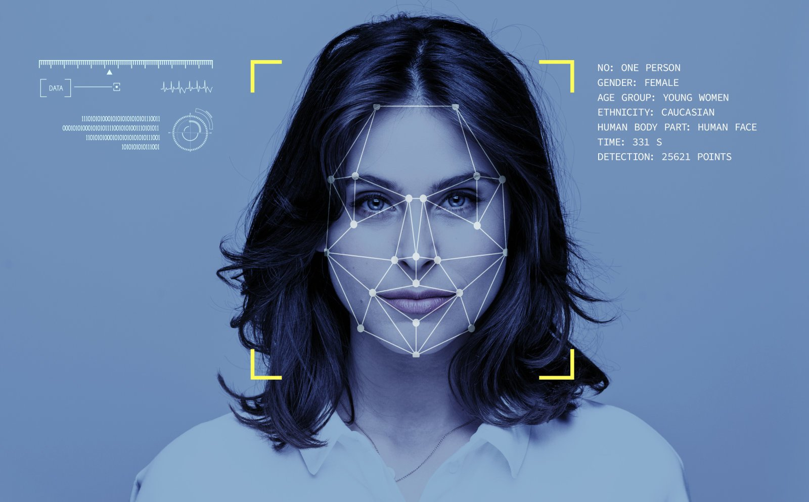
Future Work
The system can be further improved by using more images for training the classifier to detect faces with different poses and expressions.
The confidence level of detection can be improved by using deep learning techniques such as convolutional neural networks (CNNs).
The system can be optimized by experimenting with different values for the scale factor and minimum neighbors parameters in the detectMultiScale function.
The system can be extended to detect other objects such as full body, cars, and etc.
The system can be integrated with other systems such as security cameras, attendance systems, and etc.
Overall, the above system provides a solid foundation for face detection, but there is still room for improvement in terms of accuracy and efficiency. With further experimentation and optimization, it has the potential to be used in a wide range of applications.

Slide 10
Thank You

